Slide 1
STOCK PRICE PREDICTION
Pragna Pulipati (17MIS1044)

Slide 2
Problem Statement
Identifying the trends in the Stock Market as it is a significant problem because it has no clear solution, although attempts can be made at approximation using many different ML algorithms. Hence, we must build a model future usage providing User Interface with security measures like User Authentication in ML

Slide 3
Motivation
Stock price prediction is a problem that has the potential to be worth billions of rupees. Predicting the future stock prices can be difficult without any analysis or application. A general attempt to apply machine learning algorithms in order to find out stock prices and provide a different approach for giving inputs for predicting the stock prices.

Slide 4
OBJECTIVE
Identifying appropriate ML algorithm
1
4
Provide responsive website using Django for user interaction
Identify the factors influencing the Stock Price
2
3
Predicting the appropriate value in stock market

Slide 5
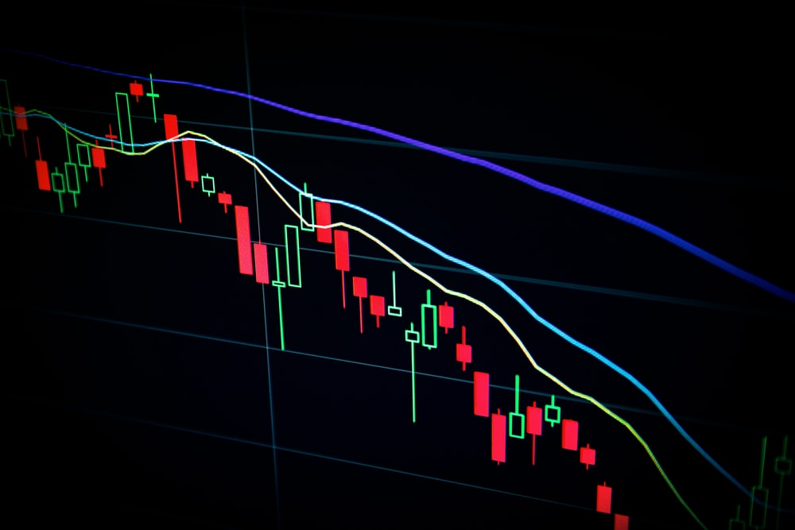
SCOPE
The main motive of this project is building a web-based application for an ML model for analysis and predicting the stocks. A Linear Regression model has been trained with the historical data of stock market values.

Slide 6
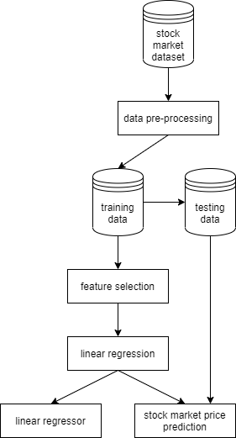
ARCHITECTURE

Slide 7
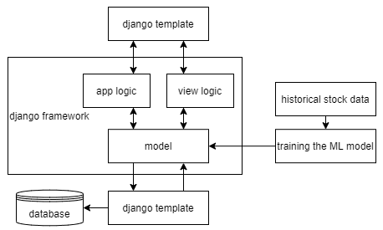
FLOW CHART

Slide 8
ALGORITHM ANALYSIS
The chosen model stands to be LINEAR REGRESSION. And this model is chosen because:
It is a linear approach to modelling the relationship between a dependent variable and one or more independent variables.
A regression line can show a positive linear relationship, a negative relationship or no relationship.
The overall idea of regressor is to examine two things:
Does a set of predictor variables do a good job in predicting a dependent variable?
Which variables in particular are significant predictors of the outcome variable and in what way do they impact the outcome?

Slide 9

MODULES
REGISTRATION
INPUT
The user must register in order to get through any other modules
The user can enter the various input features
The user must login to the website and they can predict the stock prices
The trained linear regression model is used for predicting stock prices for the given input values
LOGIN
PREDICTION

Slide 10
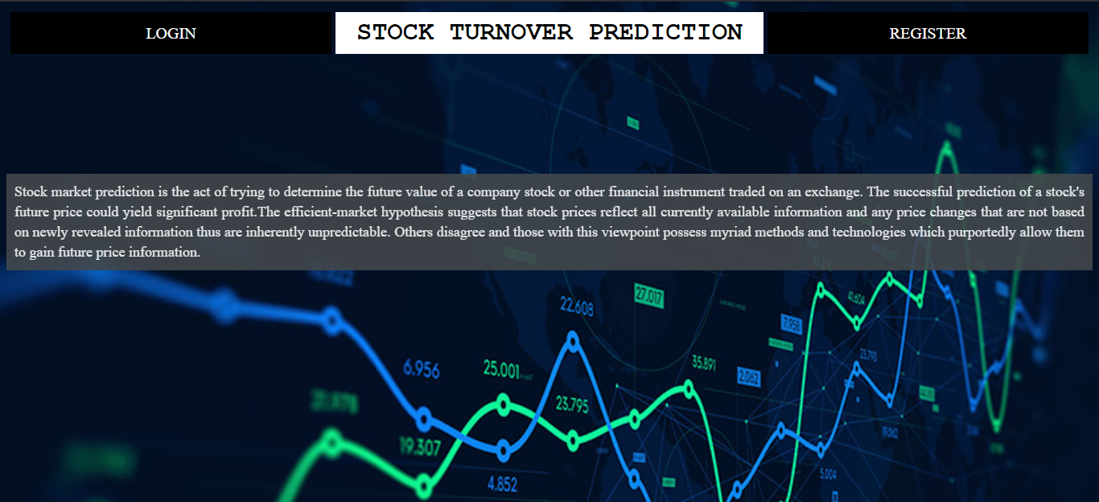
IMPLEMENTATION

Slide 11

IMPLEMENTATION

Slide 12
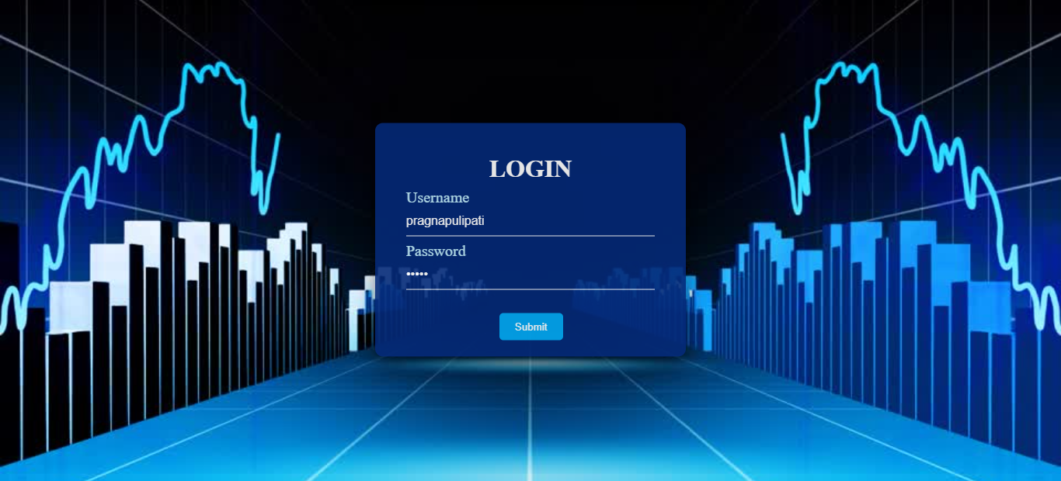
IMPLEMENTATION

Slide 13
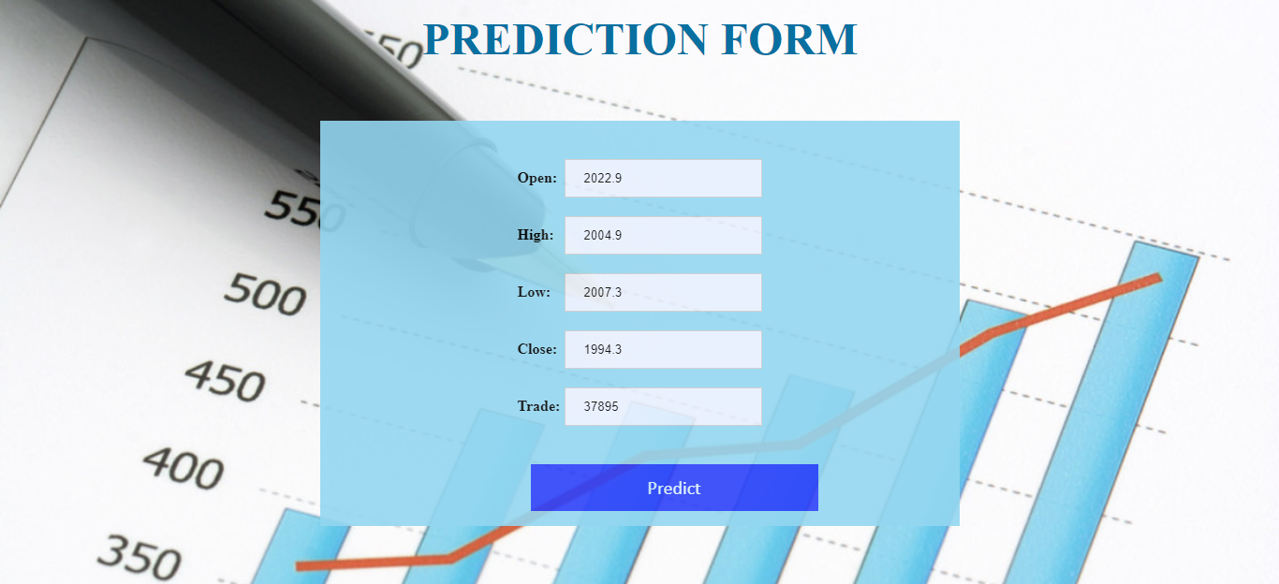
IMPLEMENTATION

Slide 14
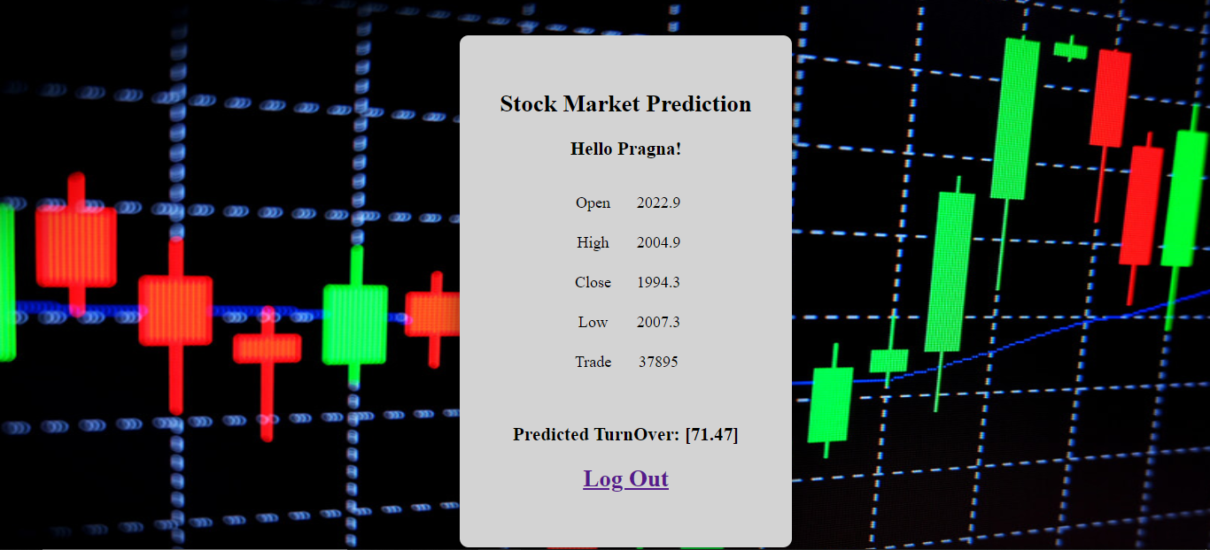
IMPLEMENTATION

Slide 15
REFERENCES
Abdulsalam, S. O., Kayode S. Adewole, and R. G. Jimoh. "Stock trend prediction using regression analysis–a data mining approach." (2011)
Dash, Ambika Prasad. Security analysis and portfolio Management. IK International Pvt Ltd, 2009.
Dunham, Margaret H. Data mining: Introductory and advanced topics. Pearson Education India, 2006.
Fama, Eugene F. "The behavior of stock-market prices." The journal of Business 38, no. 1 (1965): 34-105.
Sharma, Ashish, Dinesh Bhuriya, and Upendra Singh. "Survey of stock market prediction using machine learning approach." In 2017 International conference of electronics, communication and aerospace technology (ICECA), vol. 2, pp. 506-509. IEEE, 2017.

Slide 16
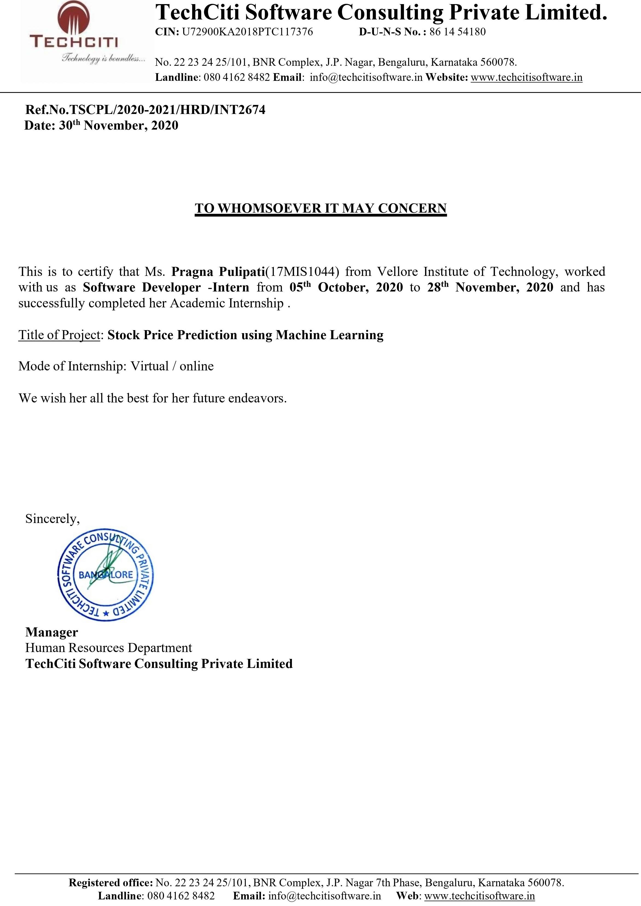
INTERNSHIP CERTIFICATE

Slide 17
THANK you!

